Slide 1
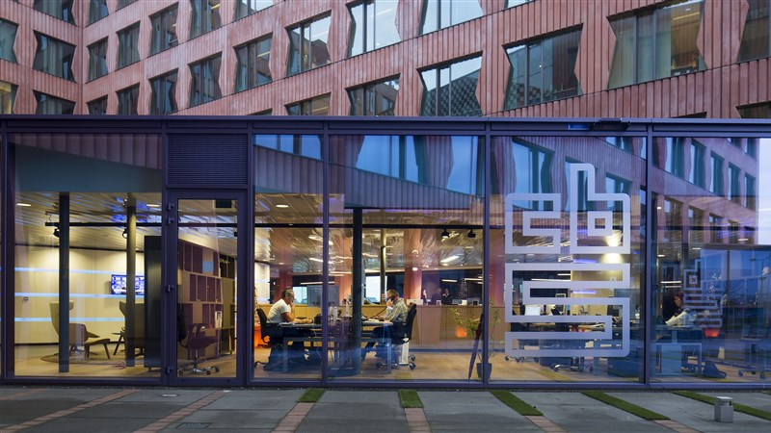
CBS Chatbot
Jan, Askin, Seyma, Timo

Slide 2
Table of contents
Findings
Upcoming Week
Word Embeddings

Slide 3
Findings
Category Analyses
01
Needs data preparation
Code cleaning
02
Improved reusability
Improved understanding

Slide 4
Category Analyses
Generalization
Lemmatization
Stopwords

Slide 5
Word Embeddings
Dense vectors of real numbers, one per word in your vocabulary
Pre-trained from Wikipedia
Distributional hypothesis

Slide 6
Upcoming Week
Unsupervised learning
01
Report
02
Categorizing questions
Experimenting methods
Method
Results

Slide 7

Questions?

